Slide 1
While You Wait
Start Kali
Check still installed. If not, download and install
PwnDbg https://github.com/pwndbg/pwndbg
Cutter https://cutter.re/
pwntools (sudo pip3 install pwntools && pip3 install pwntools)
A text editor

Slide 2

Stack Smashing
Part 3 of Binary Exploitation

Slide 3
4 Week Plan
Week 1: Assembly & Shellcoding
Writing our own assembly, writing some shellcode. Getting used to debugging tools
Week 2: Reverse Engineering
Learning some basic reversing techniques, getting used to reversing frameworks
Week 3: Stack smashing
Basic program exploitation. How to exploit programs that have little/no protections
Week 4: Return Oriented Programming
Exploiting programs with some modern protections enabled

Slide 4
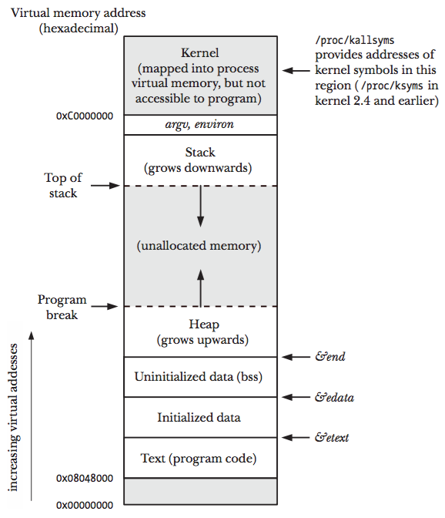
Quick Recap: The Stack
In programming, the stack is a logical data structure that obeys LIFO (Last in First Out) principle
In processes, the stack is a region of memory where data is stored
Each new function of a process gets it’s own stack frame
The stack starts at a high memory location and grows down

Slide 5
A note on Protections
OS Protection
Address Space Layout Randomization (ASLR)
Addresses on stack is randomised - harder to guess addresses in overflow
Compiler Protections
Position Independent Execution (PIE)
Binary compiled using offsets for code location. Actual locations calculated on runtime
Stack Canaries (Fortify)
Sets values that are monitored. If value changes the program stops
Non Executable Stack (NX Stack)
Remove executable permissions from the stack
Half/ Full Relocation Read Only (RelRO)
Global Offset Table Protections
Notes:
ASLR – When PIE is not enabled, ASLR only randomises the stack (Due to RIP relative addressing breaking)
PIE – Fixes relative addressing. Allows ASLR to randomize the other segments
NX Stack – Remove the executable bit from the stack
Partial RelRO – Makes sure the GOT is in the data segment, stopping the chance of buffer overflow overwriting GOT entries
Full RelRO – Makes the GOT read only, stopping the possibility of GOT overwrite attacks

Slide 6
What is Stack Smashing
Originally coined by Phrack http://phrack.org/issues/49/14.html
Stack smashing is the term used for reading malicious shellcode onto the stack and then executing it
Prerequisites:
We have a buffer overflow vulnerability
The stack is executable
If ASLR is enabled, we need a stack leak
If following along for this demo you should disable ASLR
echo 0 | sudo tee /proc/sys/kernel/randomize_va_space
Disclaimer: I never actually learned stack smashing, I learnt ROP first and so I may not have the answer to your every question, but ask anyway
Notes:
One gotcha here. GDB will disable aslr for a process by default unless attaching to a process, which can screw your exploit if you use hard coded addresses from gdb

Slide 7
Drawbacks of Stack Smashing
Very system specific
Clunky – the stack gets clobbered
Relies on no ASLR or a stack leak, even without PIE
Relies on NX Stack, or a way to bypass it
Inaccurate – nop sleds etc
Notes:
Environmental variables etc an exploit on one system might not work on another

Slide 8
Demo

Slide 9


Challenges
Challenge 1: Overwrite the return address correctly
Challenge 2: Complete a stack smash with ASLR
Challenge 3: Ret2?

Slide 10
Demo 2
1 method to defeating a canary

